Slide 1


Predicting Solar Energy Production
CHANDAN MAHATO
CONFIDENTIAL: The information in this document belongs to Boston Institute of Analytics LLC. Any unauthorized sharing of this material is prohibited and subject to legal action under breach of IP and confidentiality clauses.

Slide 2

INTRODUCTION
Title : Predicting Solar Energy Production
Objective: Understand the importance and methods of predicting solar energy output
Why It Matters:
Enables efficient grid management
Optimizes energy storage and distribution
Supports renewable energy integration
CONFIDENTIAL: The information in this document belongs to Boston Institute of Analytics LLC. Any unauthorized sharing of this material is prohibited and subject to legal action under breach of IP and confidentiality clauses.

Slide 3
Importance of Solar Energy Prediction
Reliability: Ensures stable energy supply for utilities
Cost Efficiency: Reduces reliance on backup power sources
Sustainability: Maximizes use of renewable energy
Applications:
Energy market planning
Load balancing
Policy and investment decisions
CONFIDENTIAL: The information in this document belongs to Boston Institute of Analytics LLC. Any unauthorized sharing of this material is prohibited and subject to legal action under breach of IP and confidentiality clauses.

Slide 4
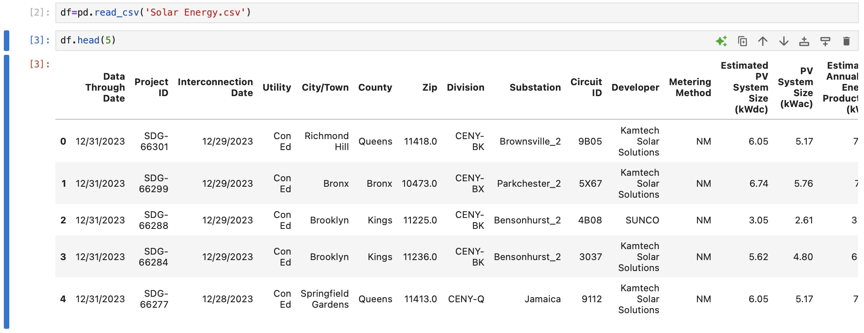
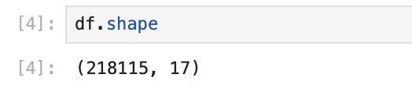
DATASET OVERVIEW
The project utilizes a dataset (solar energy.csv) containing energy production,including details such as "Data Through Date," "Project ID," "Interconnection Date," and "Estimated PV System Size (kWdc)," with the first five rows showing data from January 31, 2023, across various locations like Queens, Bronx, and Brooklyn.
CONFIDENTIAL: The information in this document belongs to Boston Institute of Analytics LLC. Any unauthorized sharing of this material is prohibited and subject to legal action under breach of IP and confidentiality clauses.

Slide 5
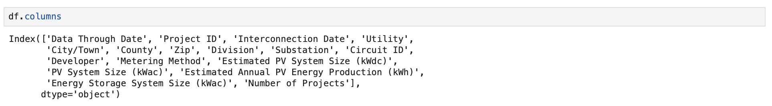
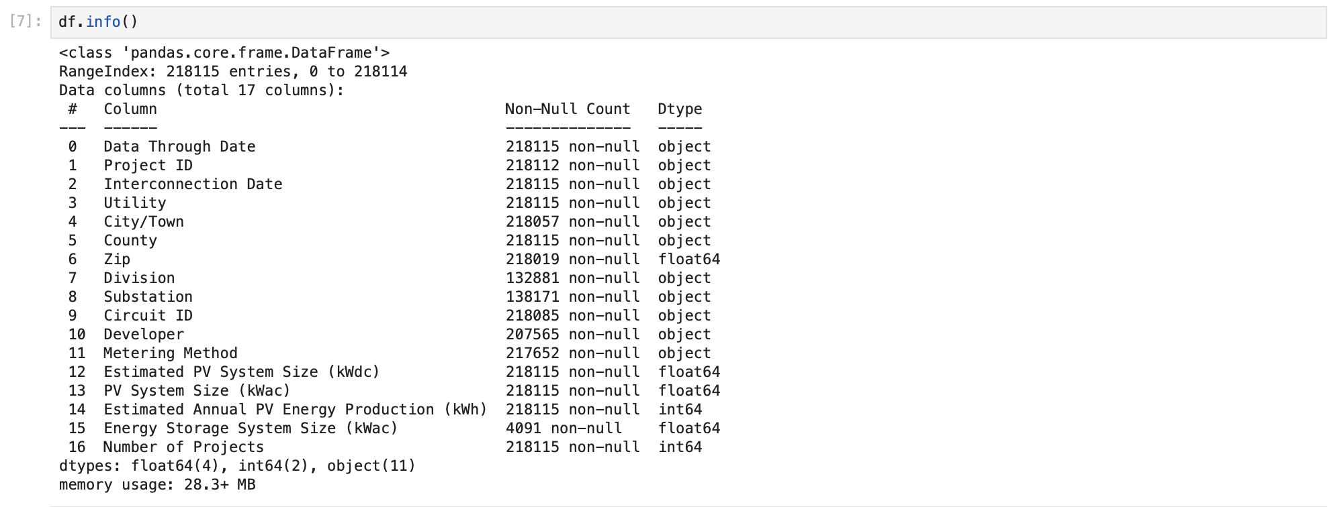
The dataset contains 218,115 entries with 17 columns, including key variables like "Metering Method," "PV System Size (kWdc)," and "Estimated Annual PV Energy Production (kWh)," all with no null values, ensuring robust data integrity.
CONFIDENTIAL: The information in this document belongs to Boston Institute of Analytics LLC. Any unauthorized sharing of this material is prohibited and subject to legal action under breach of IP and confidentiality clauses.

Slide 6
METHODOLOGY
Steps:
Exploratory Data Analysis (EDA) to understand patterns.
Feature engineering to enhance model performance.
Evaluation using F1-score, ROC-AUC.
Model training
Deployment
CONFIDENTIAL: The information in this document belongs to Boston Institute of Analytics LLC. Any unauthorized sharing of this material is prohibited and subject to legal action under breach of IP and confidentiality clauses.

Slide 7
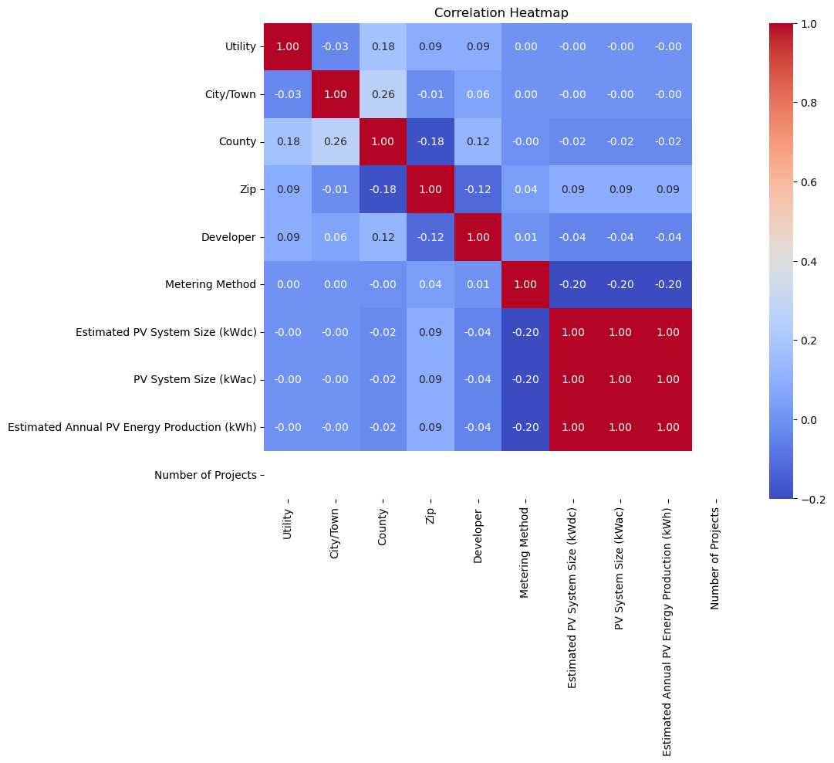
EDA (Exploratory Data Analysis)
EDA is the process of examining and visualizing data to understand its patterns, trends, and characteristics.
For Example: Correlation Matrix
Correlation heatmap visually highlights the relationships between different numeric features, helping to identify strong correlations that could inform feature selection and engineering
CONFIDENTIAL: The information in this document belongs to Boston Institute of Analytics LLC. Any unauthorized sharing of this material is prohibited and subject to legal action under breach of IP and confidentiality clauses.

Slide 8
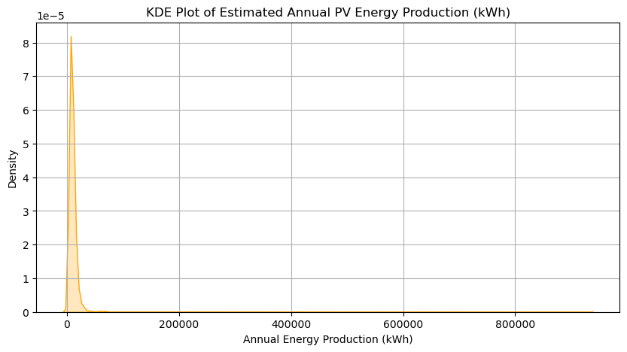
EDA (Exploratory Data Analysis)
KDE Plot shows a peak at 0 kWh (most systems low production), right-skewed to 800,000 kWh (fewer large systems), and wide range (0-800,000 kWh) indicating diverse scales
CONFIDENTIAL: The information in this document belongs to Boston Institute of Analytics LLC. Any unauthorized sharing of this material is prohibited and subject to legal action under breach of IP and confidentiality clauses.

Slide 9
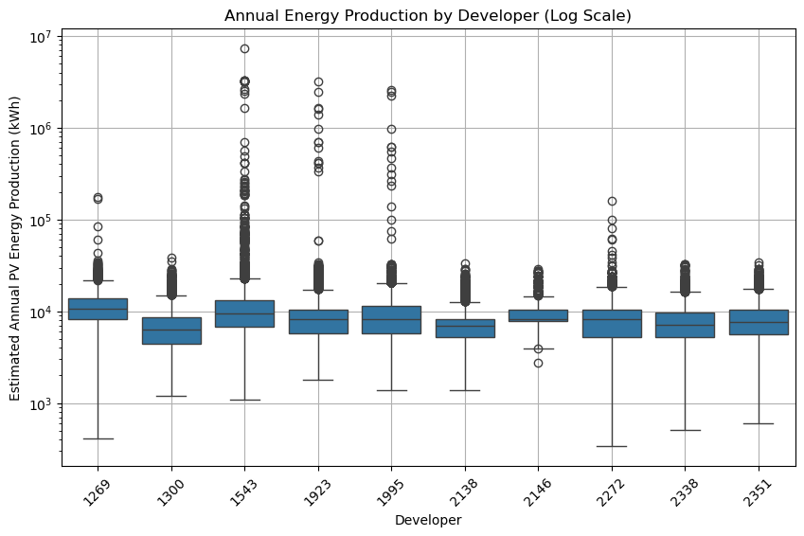
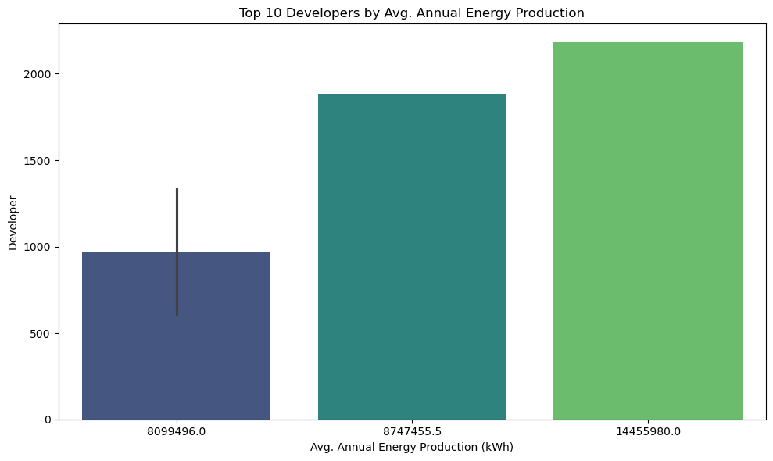
Energy production by Developer
Developer 1543 has the widest spread and highest median (around 10⁵ kWh), suggesting diverse and higher production, while others like 2146 and 2351 show narrower ranges and lower medians (around 10⁴ kWh), indicating more consistent but lower output.
CONFIDENTIAL: The information in this document belongs to Boston Institute of Analytics LLC. Any unauthorized sharing of this material is prohibited and subject to legal action under breach of IP and confidentiality clauses.

Slide 10
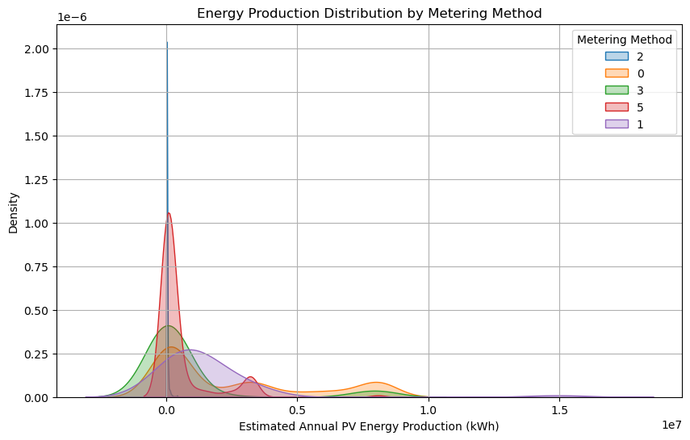
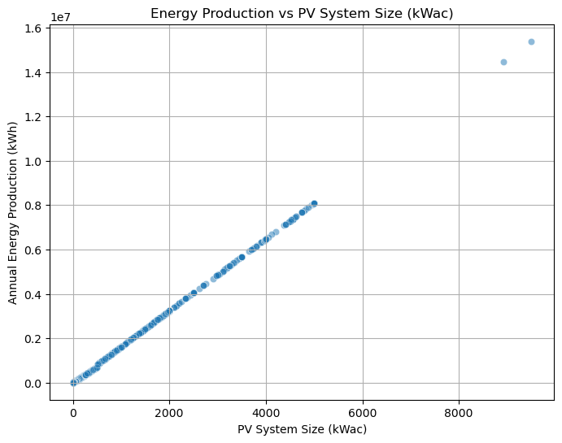
Energy production vs PV System Size
Scatter plot shows a positive correlation between PV system size (0-8000 kWac) and annual energy production (0-1.6×10⁷ kWh), with a diagonal trend and some high-production outliers.
KDE plot indicates blue metering method (2) peaks highest at low production (~0.5 on log scale 0-1.5×10⁷ kWh), while others (0, 3, 5, 1) show flatter, diverse distributions.
CONFIDENTIAL: The information in this document belongs to Boston Institute of Analytics LLC. Any unauthorized sharing of this material is prohibited and subject to legal action under breach of IP and confidentiality clauses.

Slide 11
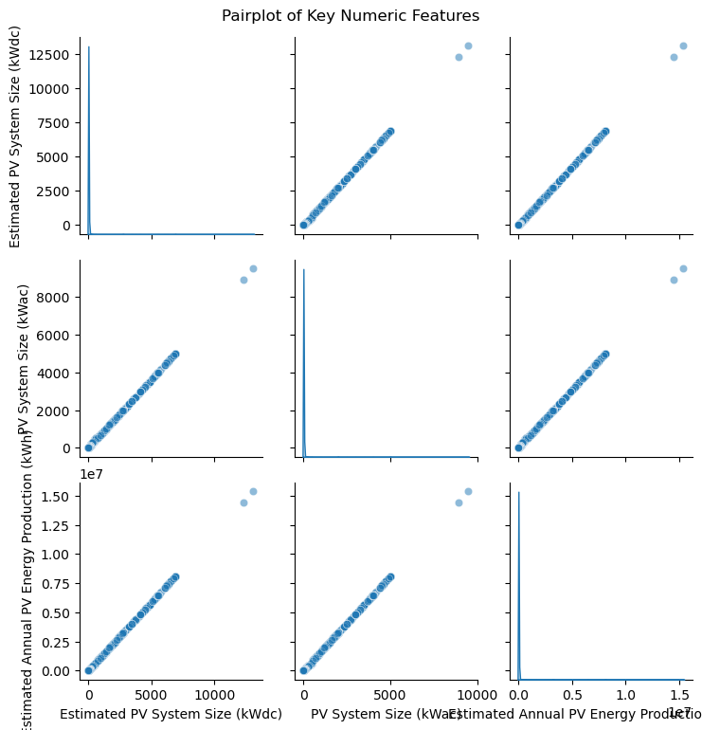
Features Engineering
Feature engineering is vital for enhancing the performance of our fraud detection model.
It involves identifying and creating relevant features, such as transaction frequency and average transaction amount, to capture complex patterns.
We also encode categorical variables for numerical analysis, normalize numerical features, and handle missing values to ensure data integrity.
We checked the outliers.
Also we splitted data into Test and Train for evaluation purpose.
CONFIDENTIAL: The information in this document belongs to Boston Institute of Analytics LLC. Any unauthorized sharing of this material is prohibited and subject to legal action under breach of IP and confidentiality clauses.

Slide 12
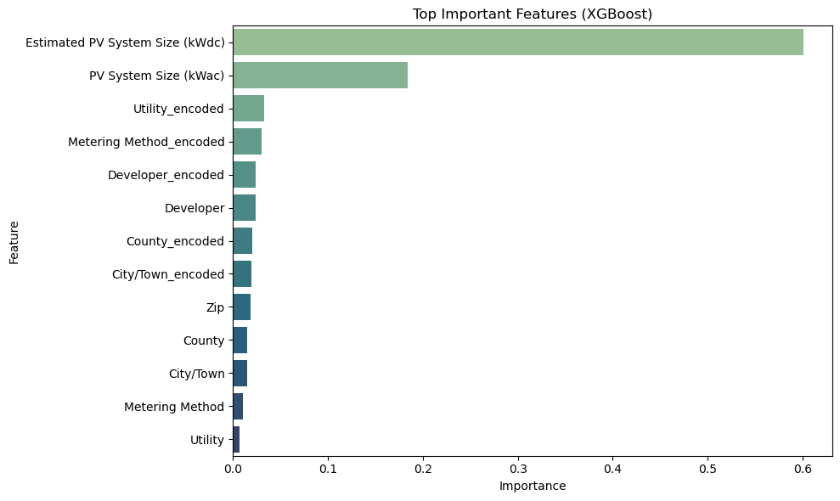
Bar chart highlights "Estimated PV System Size (kWdc)" as the most important feature (importance ~0.6), followed by "PV System Size (kWac)" (~0.25), with "Utility_encoded" and "Metering Method_encoded" showing moderate importance (~0.1-0.15), while "Developer," "County_encoded," "City/Town_encoded," "Zip," "County," "City/Town," "Metering Method," and "Utility" have minimal impact (<0.1), indicating system size metrics are key predictors in the model.
CONFIDENTIAL: The information in this document belongs to Boston Institute of Analytics LLC. Any unauthorized sharing of this material is prohibited and subject to legal action under breach of IP and confidentiality clauses.

Slide 13
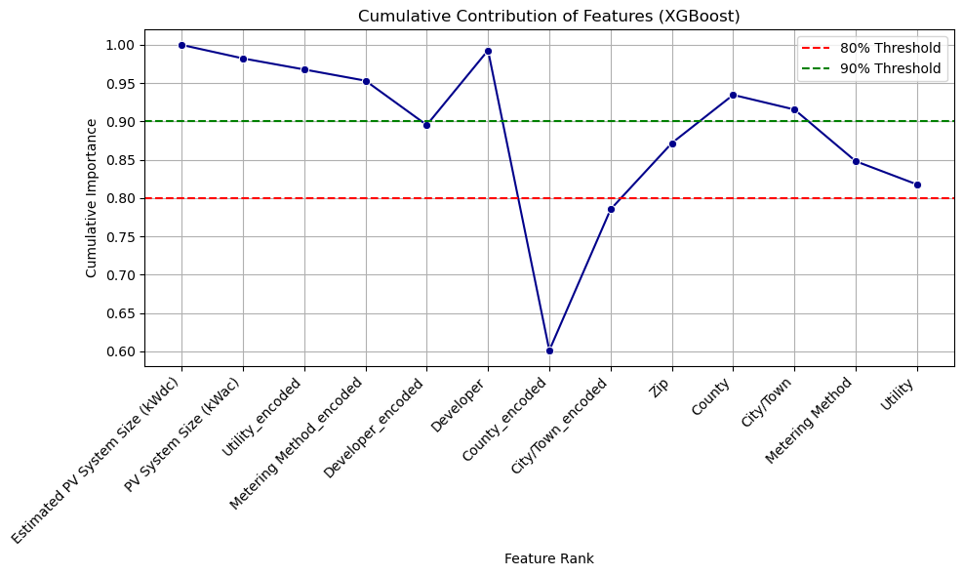
Line chart shows the cumulative importance of features, starting with "Estimated PV System Size (kWdc)" and "PV System Size (kWac)" contributing nearly 1.0, with a dip to ~0.6 at "Developer," then rising to ~0.95 by "City/Town_encoded" before dropping to ~0.8 at "Utility"—the 80% threshold (red line) is crossed early, while 90% (green line) is reached around "City/Town_encoded," indicating top features like system sizes dominate predictive power.
CONFIDENTIAL: The information in this document belongs to Boston Institute of Analytics LLC. Any unauthorized sharing of this material is prohibited and subject to legal action under breach of IP and confidentiality clauses.

Slide 14
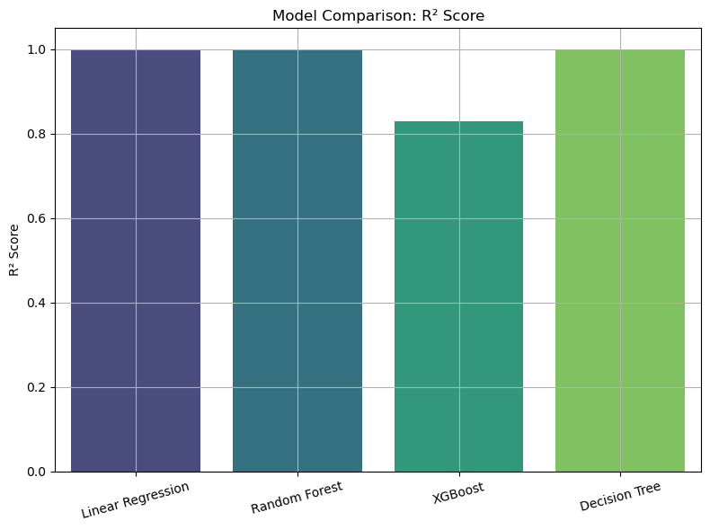
MODEL EVALUATION
We tested different classifiers like Logistic Regression, Random Forest, SVC and XGBoost(Extreme Gradient Boosting).
Each method has its own benefits; for example, Random Forest is good at avoiding overfitting and works well with big datasets, while XGBoost often provides high accuracy by combining multiple models.
CONFIDENTIAL: The information in this document belongs to Boston Institute of Analytics LLC. Any unauthorized sharing of this material is prohibited and subject to legal action under breach of IP and confidentiality clauses.

Slide 15
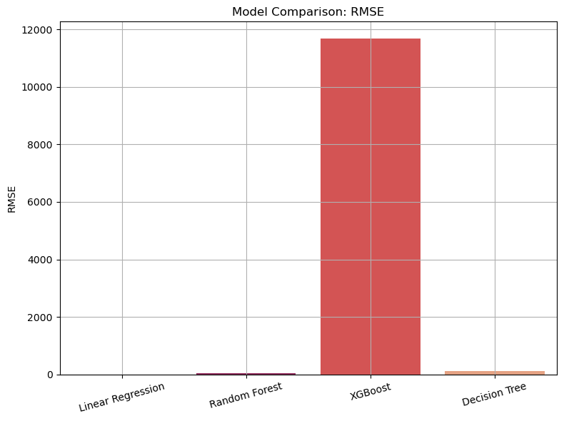
MODEL COMPARISON
Since the r2 score of other model such as Linear Regression, Random Forest & Decision tree is exactly 1 so , it indicates overfitting. Now to avoid overfit , I have trained the model with XGBoost
CONFIDENTIAL: The information in this document belongs to Boston Institute of Analytics LLC. Any unauthorized sharing of this material is prohibited and subject to legal action under breach of IP and confidentiality clauses.

Slide 16
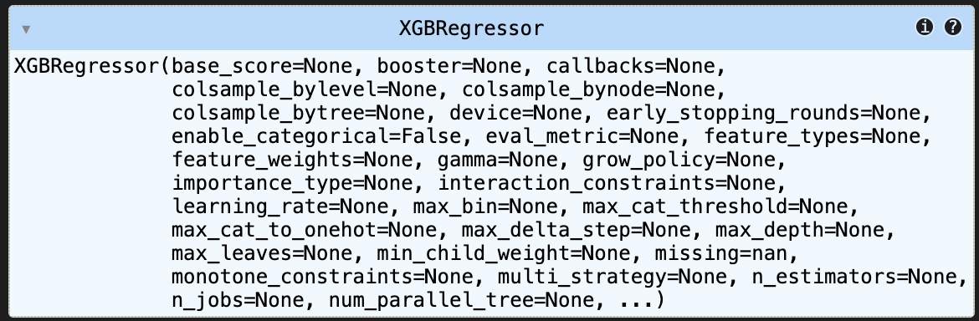
MODEL TRAINING
XGBoost provides a reliable baseline with an R² of 0.866 and RMSE of 10,345.21.
CONFIDENTIAL: The information in this document belongs to Boston Institute of Analytics LLC. Any unauthorized sharing of this material is prohibited and subject to legal action under breach of IP and confidentiality clauses.

Slide 17
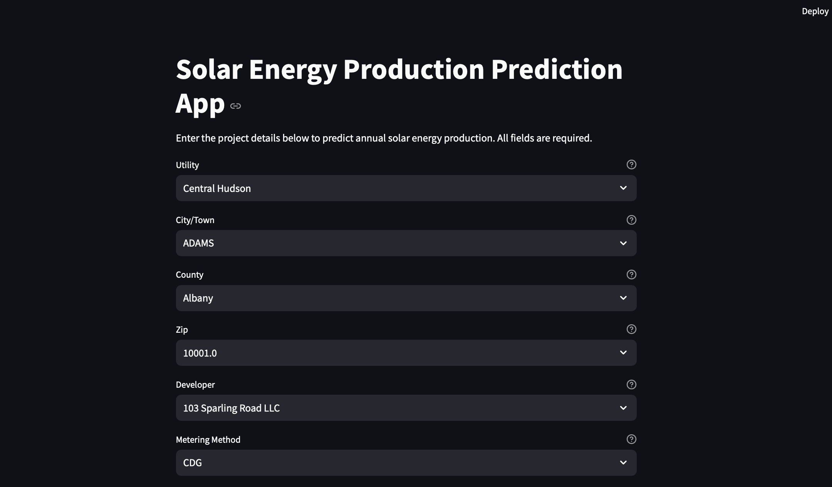
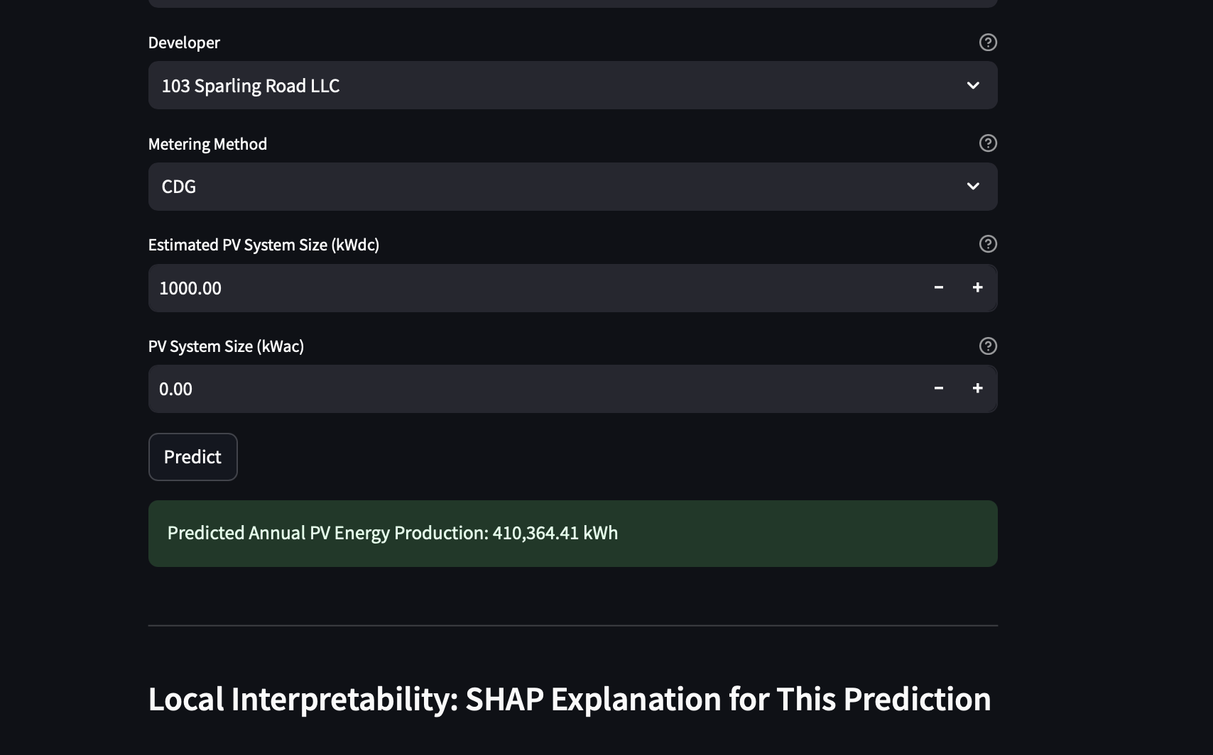
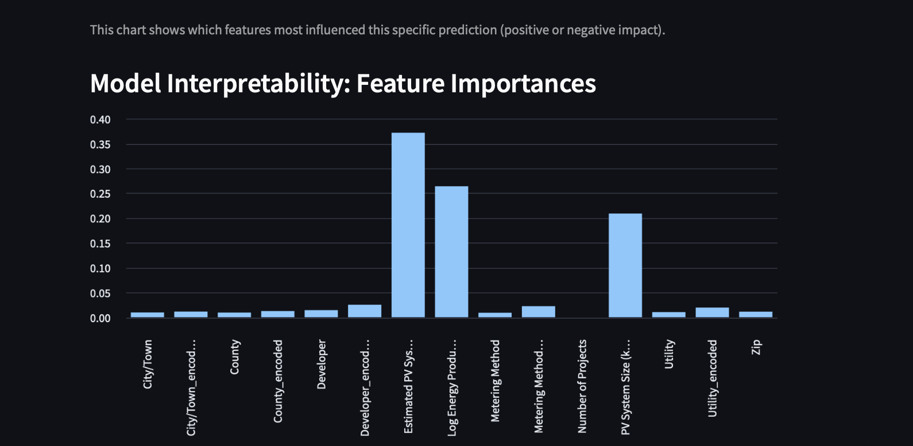
OUTPUT
CONFIDENTIAL: The information in this document belongs to Boston Institute of Analytics LLC. Any unauthorized sharing of this material is prohibited and subject to legal action under breach of IP and confidentiality clauses.

Slide 18
CONCLUSION
Using the XGBoost model, we successfully predicted the Estimated Annual PV Energy Production (kWh).
The model performed well on our skewed dataset, which mainly contains low to medium energy-producing solar projects, with a few high-output outliers.
This suggests that while most installations are small-scale, there is significant potential for large-scale production.
These predictions can support efficient planning and deployment of solar energy systems.
CONFIDENTIAL: The information in this document belongs to Boston Institute of Analytics LLC. Any unauthorized sharing of this material is prohibited and subject to legal action under breach of IP and confidentiality clauses.

